Slide 1
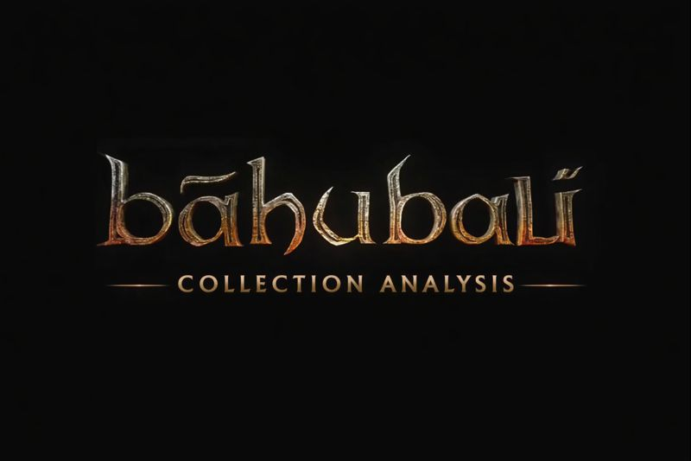

Slide 2



About the Flim - Baahubali
Baahubali is a two-part Indian epic action–fantasy film series directed by S. S. Rajamouli.
The franchise includes:
Baahubali: The Beginning (2015)
Baahubali: The Conclusion (2017)
It was simultaneously shot in Telugu and Tamil and later dubbed into multiple Indian and international languages.
The film is set in the fictional kingdom of Mahishmati and revolves around power, sacrifice, betrayal, and heroism.
Baahubali is regarded as a milestone in Indian cinema due to its grand scale, storytelling, and visual effects.

Slide 3

Flim Details, Scale & Impact
Main Cast: Prabhas, Rana Daggubati, Anushka Shetty, Tamannaah, Ramya Krishnan
Genre: Epic • Action • Drama • Fantasy
Production Scale:
● One of the highest-budget Indian films at the time.
● Massive war sequences, grand sets, and advanced VFX.
Technical Excellence:
● High-quality CGI and motion graphics.
● Strong background score by M. M. Keeravani.
Impact & Legacy:
● Became a pan-India blockbuster.
● Set new benchmarks for storytelling and box-office success.
● Popularized the use of large-scale dashboards and analytics to study movie performance.

Slide 4


Movie Planning & Vision
The Baahubali project was planned as a two-part epic franchise to ensure detailed storytelling.
Extensive pre-production planning was done for script development, set design, costumes, and VFX.
The fictional kingdom of Mahishmati was carefully conceptualized to create a unique cinematic world.
Production Cost & Investment
Baahubali was among the most expensive Indian film projects at the time of release.
Major costs were incurred for:
Large-scale sets and war sequences
Advanced visual effects (VFX)
High-end action choreography
Significant investment was made to ensure international-quality production standards.

Slide 5


Promotion & Marketing Platforms
The movie was promoted aggressively using:
Television advertisements
Social media platforms (YouTube, Facebook, Twitter)
Trailers, teasers, and poster launches
Pre-release events and press meets across India
Multi-language releases helped the film reach a pan-India audience.
Audience Response & Reception
The film received an overwhelming response from audiences across regions.
Viewers appreciated:
Visual grandeur
Strong characters and emotional depth
Engaging storyline and action sequences
Positive word-of-mouth played a key role in sustaining box-office success.

Slide 6
Objective of the Dashboard
The Baahubali dashboard was created to analyze the movie’s performance using data visualization. Main objectives include:
● Analyzing budget and box-office collection.
● Understanding profit and return on investment.
● Studying ratings and audience response.
● Presenting insights in a simple and visual manner.
Dashboard Creation Process:
• Collected the Baahubali movie dataset from reliable sources. • Cleaned and organized the data for accurate analysis. • Imported the dataset into the visualization tool. • Created charts and KPIs to represent key metrics. • Applied filters and formatting for better clarity. • Analyzed the results and derived insights from the dashboard.
.

Slide 7
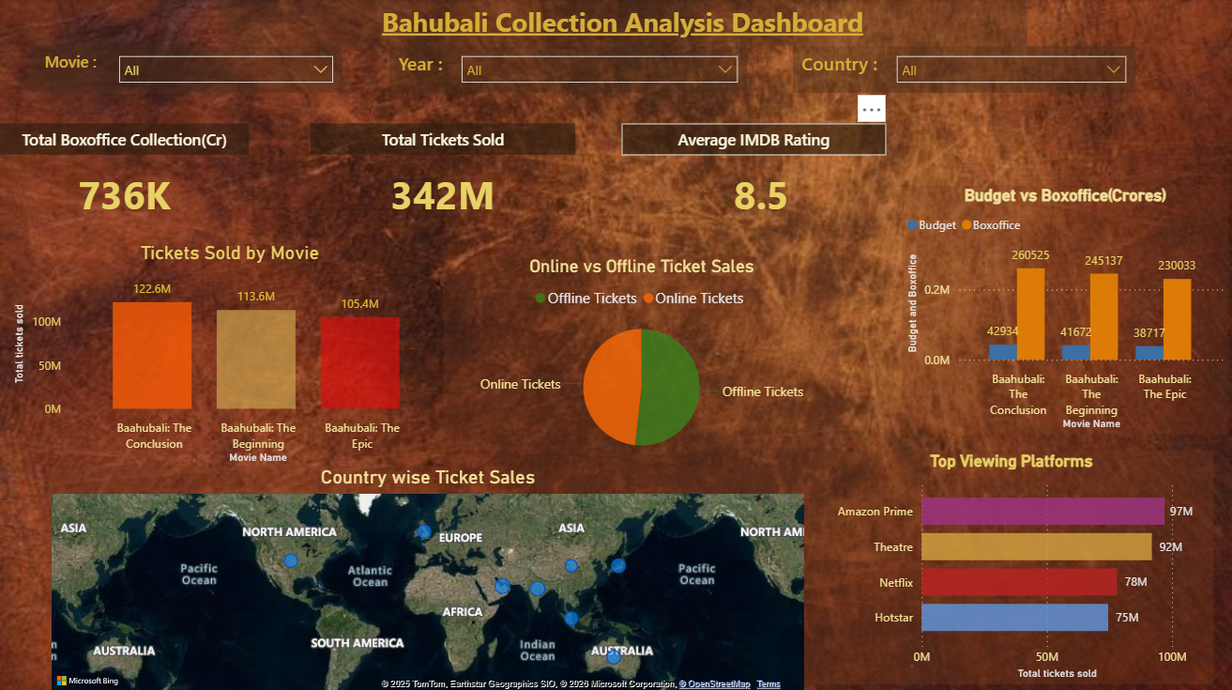
Dashboard Overview & Key Metrics
The dashboard presents data using Slicers, Cards,column charts,bar Chart,Pie chart and Map.
Key metrics displayed include:
● Total budget.
● Worldwide box-office collection.
● Profit or loss.
● Average ratings.
● Total Tickets Sold.
● Viewing Platforms.
Visual tools such as bar charts and comparison graphs help understand performance..

Slide 8
Insights
The dashboard analysis clearly shows that Baahubali achieved exceptional commercial success. Despite a very high production cost, the movie generated massive box-office revenue, resulting in a strong return on investment. High audience ratings and positive reviews indicate strong audience acceptance across different regions. Effective planning, large-scale promotions, and quality production played a key role in the movie’s overall performance.
Conclusion
The Baahubali dashboard demonstrates how data visualization helps in understanding movie performance in a simple and effective manner. By analyzing budget, revenue, and audience response through dashboards, complex data can be converted into meaningful insights. This study proves that dashboards are powerful tools for evaluating the financial and commercial success of films.

Slide 9


